Slide 1
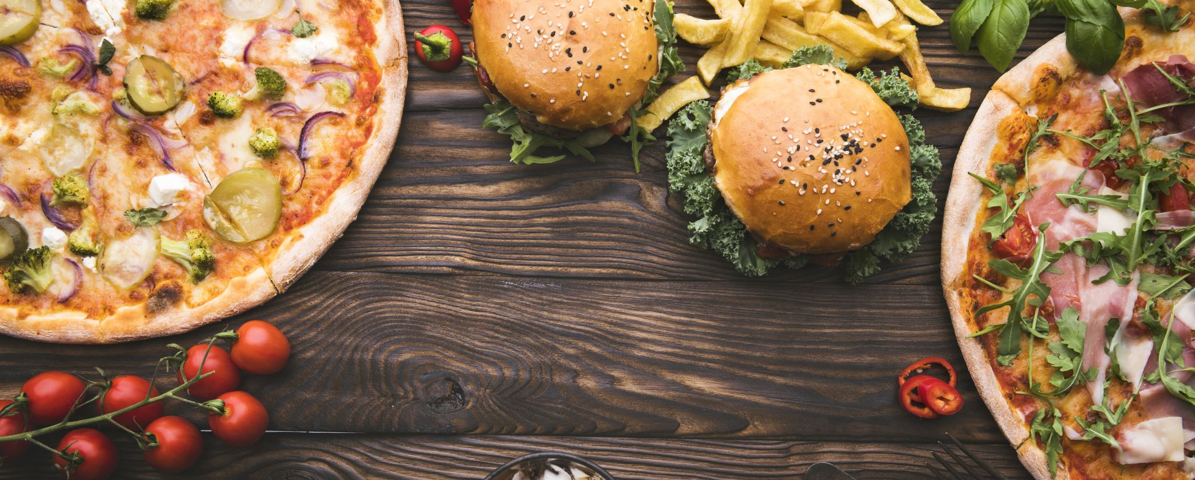
The Food Detectives
Project Proposal

Slide 2
Team Members
Brian Colantonio – Project visionary and Lead Programmer
Dercio Torres - Primary Front-End Developer
Michael Day – Primary Database Programmer

Slide 3

Mission Statement
Whether it be allergies, dietary restrictions, or ethical standards, its fair to assume that most of us have other activities we prefer over standing around in grocery stores and reading product labels.
Our application is designed to quickly and easily provide all the information you will need to maintain your eating lifestyle.
Our time is valuable. Let’s take it back!

Slide 4

Project Technical Specs
Project development plan
TECHNICAL SPECS
How We Will Complete This Project

Slide 5





Technologies Used

Slide 6
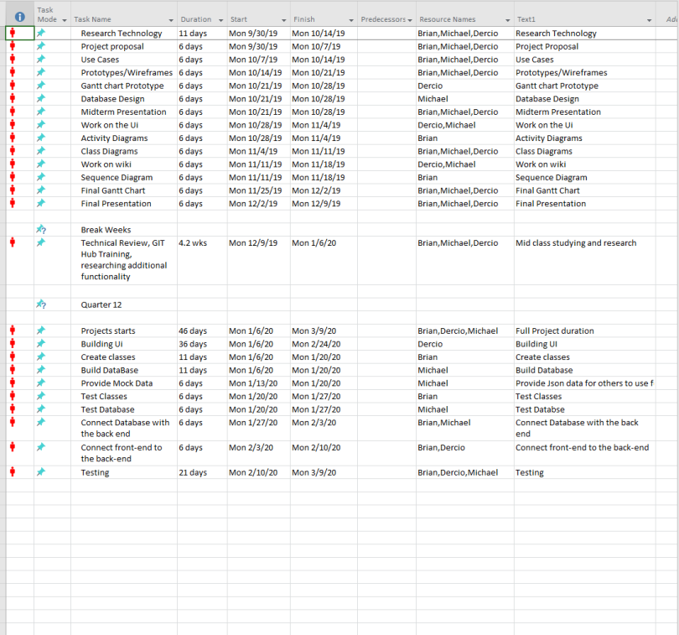
Gantt Chart

Slide 7
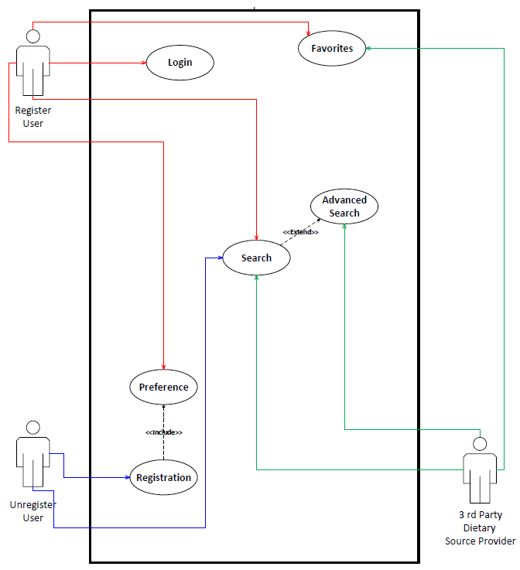
Use Case Diagrams

Slide 8
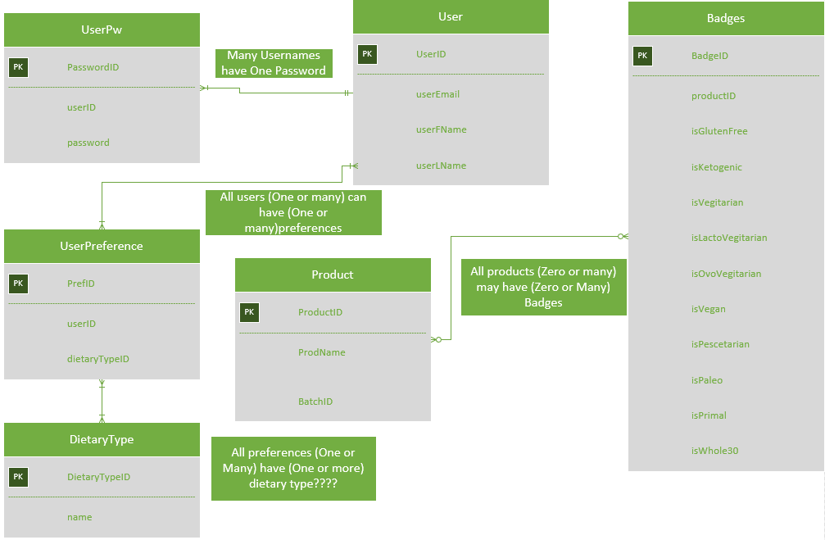
Entity Relationship Diagrams

Slide 9
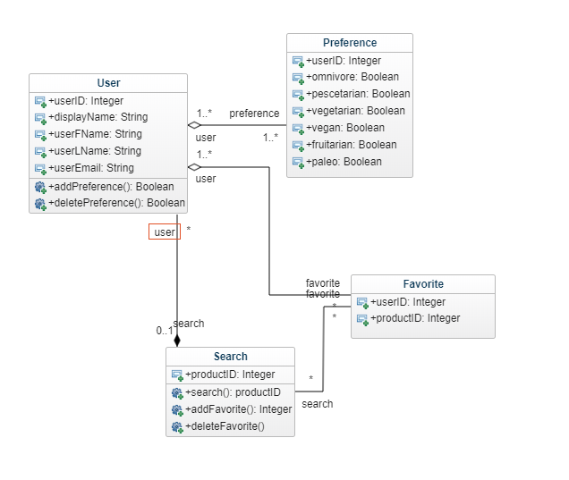
Class Diagrams

Slide 10
USER EXPERIENCE
How users will interact with our website

Slide 11
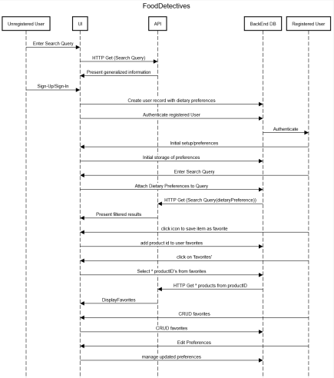
Sequence Diagrams

Slide 12
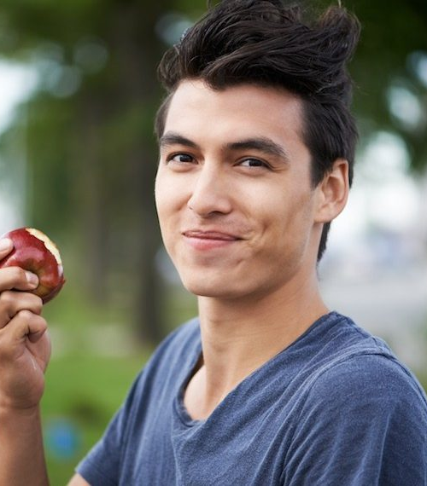
Sam – Unregistered User

Slide 13
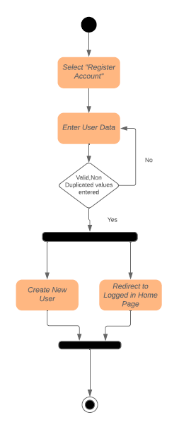
Sam’s(optional) Registration Experience

Slide 14
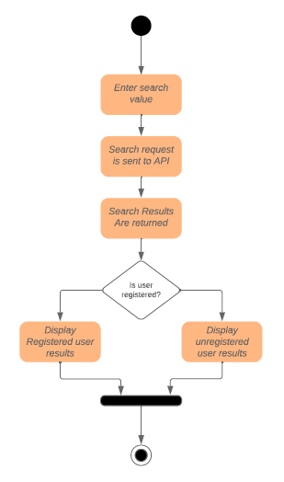
Sam’s Search Experience

Slide 15

Sarah –Registered User

Slide 16
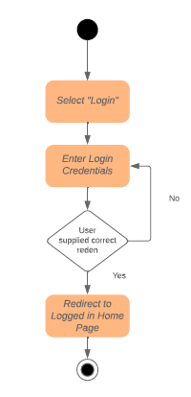
Sarah’s Login Experience

Slide 17
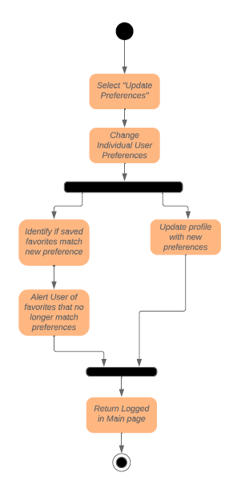
Sarah’s Preferences Experience

Slide 18
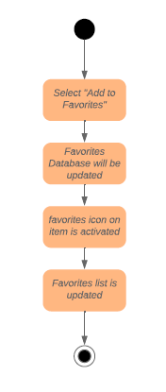
Sarah’s Favorites Experience

Slide 19
Sarah’s Search Experience

Slide 20


